Slide 1

Post-Quantum Blockchain Security (TGG6)
Mitigating Quantum Threats in Blockchain Transactions
TEAM 18
Souhardya Ghosh 23BLC1064
Shazeb Amman 23BLC1121
Garav Malik 23BLC1091
Sarmad Sultan 23BLC1056
Ayush Kashyap 23BLC1138

Slide 2

Why is Blockchain at Risk?
Quantum computing poses a new class of risks for blockchain networks.
Cryptographic Weakness
Algorithm Vulnerabilities
Quantum computing can break ECDSA & RSA cryptographic methods.
Shor's algorithm factors large numbers, compromising RSA.
Data Search
Grover's algorithm speeds up searching unsorted databases.

Slide 3
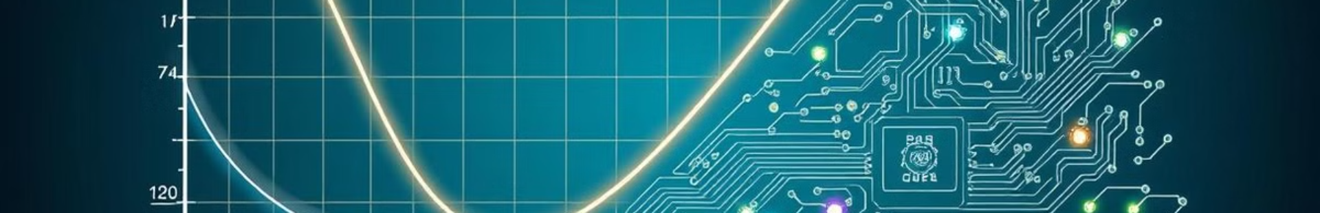




ECDSA Vulnerabilities
Quantum computers could solve Elliptic Curve Discrete Logarithm Problem (ECDLP).
Private Keys
Attackers derive private keys from public keys.
Fraudulent Transactions
Enabling fraudulent transactions.
RSA Cracking
2048-bit RSA cracked by quantum computer (~4000 qubits).

Slide 4




RSA Vulnerabilities
Shor's algorithm can factor large prime numbers used in RSA encryption.
Compromised Keys
Unauthorized Access
Insecure Systems
Compromised RSA keys lead to data breaches.
Unauthorized access to data.
Quantum attacks render RSA-based systems insecure.

Slide 5
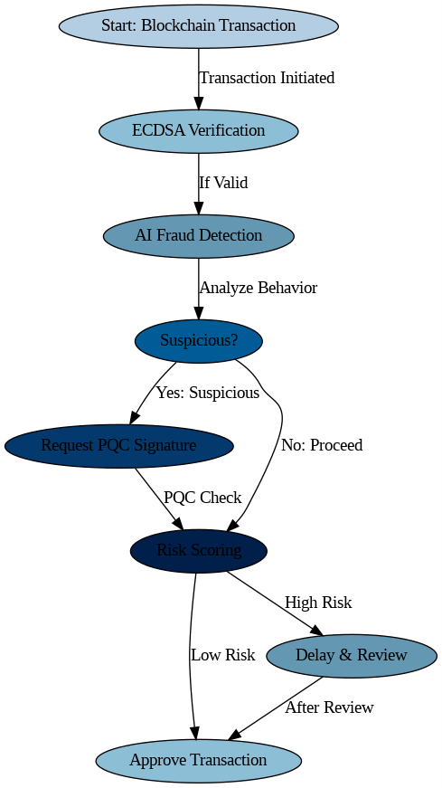
Quantum-Resistant Cryptography
Post-Quantum Cryptography (PQC) algorithms resist quantum attacks.
NIST Standardization
Lattice-Based Cryptography
NIST's PQC standardization process identifies robust algorithms.
Lattice-based cryptography offers strong security.
Hash-Based Signatures
Hash-based signatures resist classical and quantum attacks.

Slide 6

Lattice-Based Cryptography
Based on the hardness of problems on mathematical lattices.
CRYSTALS-Kyber
CRYSTALS-Dilithium
Key encapsulation: Fast and efficient.
Digital signatures: Provides high security levels.
High-security assurance while maintaining efficiency.
Based on lattice hardness problems, which remain secure even with
quantum advancements.
Suitable for blockchain security, financial systems, and digital identities.
Recommended by NIST as a post-quantum cryptographic standard.
Resistant to known quantum algorithms and a leading
candidate for PQC standardization.
Resistant to Shor’s Algorithm and other quantum attacks.
Designed for low-latency communication in real-world
cryptographic applications.

Slide 7

Hash-Based Signatures
Based on cryptographic hash functions offering high security against quantum attacks.
SPHINCS+
Collision Resistance
Stateless and offers good performance.
Security is based on hash function collision resistance.
Signature Size
Larger signature sizes compared to other PQC methods.

Slide 8




Mitigation Strategies for Blockchains
Protect blockchain infrastructure with a combination of strategies.
Hybrid Approach
Combines classical cryptographic methods
with quantum-resistant algorithms.
1
Key Rotation
Regularly updates cryptographic
keys to minimize risks
2
Forking
Creates a new version of the blockchain
to implement quantum-safe protocols.
4
Algorithm Agility
Blockchain systems should be designed to
adapt to new cryptographic standards.
3

Slide 9
Case Studies & Implementations
Real-world examples of blockchains adopting PQC measures are emerging.
QANplatform
IBM
Quantum-resistant Layer 1 blockchain.
Hybrid Approach: Combines classical and quantum-safe
cryptographic methods.
Smart Contract Security: Ensures post-quantum protection
for decentralized applications (dApps).
Fast and Energy Efficient: Designed to support enterprise-level
blockchain solutions.
Use Cases: Secure financial transactions, supply chain
tracking, and digital identities.
Developing quantum-safe blockchain solutions.
IBM’s Cryptographic Research: Leading advancements in
lattice-based cryptography for blockchain security.
ZK-Proofs & PQC Integration: Exploring the use of
zero-knowledge proofs combined with quantum-resistant
algorithms.
Hyperledger Integration: Bringing post-quantum cryptographic
standards to Hyperledger Fabric.

Slide 10

Conclusion
Proactive mitigation strategies are crucial to protect blockchain infrastructure.
Significant Threat
Viable Solutions
Staying Informed

